Slide 1

AIRLINE MANAGEMENT SYSTEM
Mitali Chaudhari 20104104
Sampada Mahadik 20104092
Sakshi Parab 20104059
Parthavi Khatu 20104108
Project Guide
Mr. Ganesh Gourshete

Slide 2
Contents
Introduction
Objectives
Scope
Features / Functionality
Project Outcomes
Technology Stack
Block Diagram if applicable

Slide 3
1. Introduction
Airline Management System is a computerized system used to store and retrieve information and conduct transactions related to air travel.
The project is aimed at exposing the relevance and importance of Airline Management Systems.
It is projected towards enhancing the relationship between customers and airline.

Slide 4
1. Introduction
Problem Identified
Normally a person wants to reserve his ticket he has to find the quickest flight to destination .
Solution Proposed
This System provides an interface to schedule flights and reservations for an airline through internet and find the quickest flight.

Slide 5
2. Objectives
To manage flight schedules, book tickets, and make payments.
To manage all the information about passenger reservation, booking enquiry.
To build an application program to reduce the manual work for managing details through internet.
To simplify the task for airlines and to easily operate.
To offer many advantages for both travellers and airlines, including security , flexibility, cost, and convenience.

Slide 6
3. Scope
The developed application will facilitate online booking, keep customer records.
Provides an online menu on flight schedules, destinations and their prices.
It will allow new customers to sign up for online access.
It also makes the life of the airline service companies easier by keeping all the records of the passengers.

Slide 7
4. Feature /Functionality
User-friendly interface.
Free account.
Fully detailed flights.
Easy cancellation process.
Easy refunds.
Easy to integrate with the application.
It is secure.
Easy to edit and view your details.

Slide 8
5. Outcome of Project
User can log in if he/she already have an account
User can register.
Customer can book flight according to their convenience.
They can make payment and can also cancel the flights incase of any emergency.
Airline administration systems can modify, add, or remove the flights details.

Slide 9
6. Technology Stack
FRONTEND
Netbeans IDE -- Version 20.4
Java JDK -- Oracle SE Development Kit 17
JRE -- Oracle Jre 8
BACKEND
Administration database – Mysql
Xampp server

Slide 10
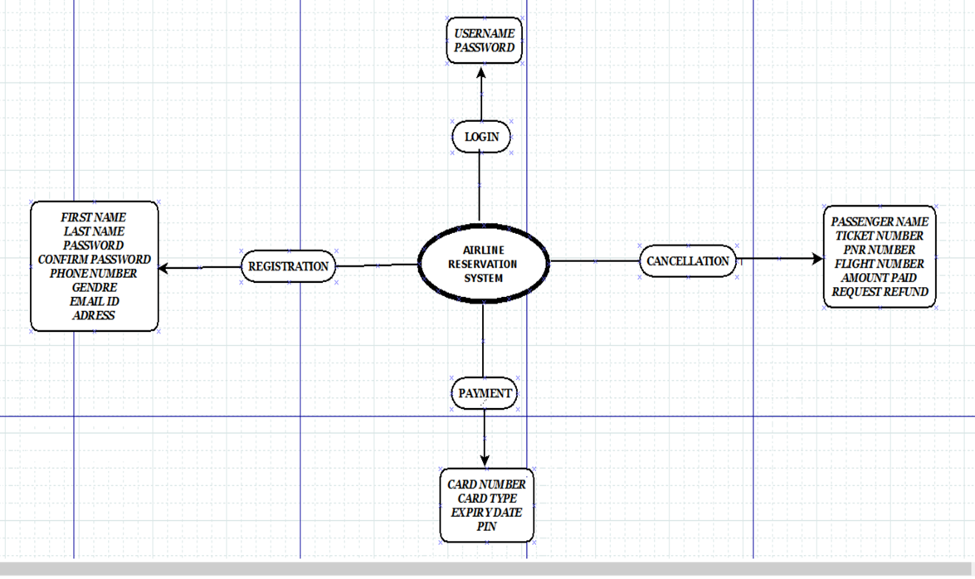
7. Block Diagram ( if applicable)

Slide 11
Thank You...!!

